Slide 1












Leftover
What we do with Spotipy
Business values
AGENDA
Spotipy
Data collection
Data processing
Leftover．7 topics, 14min 4 sec
...
Findings
Challenges and next steps
# TOPIC | PRESENTER
What we do with Spotipy | Jack@Leftover | 1:12
Business values | Jack@Leftover | 2:03
Data collection | Thomas@Leftover | 1:57
Data processing | Thomas@Leftover | 1:01
Findings | Alvis@Leftover, Jeffery@Leftover | 5:49
Challenges and next steps | Jeffery@Leftover | 1:04
Conclusion | Jack@Leftover | 0:58
Conclusion

Slide 2

What we do with Spotipy
Leftover
What we do with Spotipy
Hong Kong music industry is dead
The young have no charisma
The new artists could not sing and dance
The 80s’ and 90s’ songs are always the best
Limited choices for Canto pop
People are forgetful and would switch soon
K-pop is wayyyyy better
Hong Kong music can’t make money
Business values
Data collection
Data processing
Findings
Challenges and next steps
Conclusion
What we do with Spotipy?
Leftover

Slide 3

Business values
Leftover
What we do with Spotipy
Business values
Spotify | Competitors | Producers/ singers | Spotify users/ fans | Commercials
Performance | Streams and growth rate | Factors of a hit song | Identity | Advertising
App layout | Types of Songs Popularity | Predictions for awards ceremony | Tracking | Top artists/songs
Ads placement | Popular music companies/labels |  | Gossip
Data collection
Data processing
Findings
Challenges and next steps
Conclusion
Business values
Leftover

Slide 4
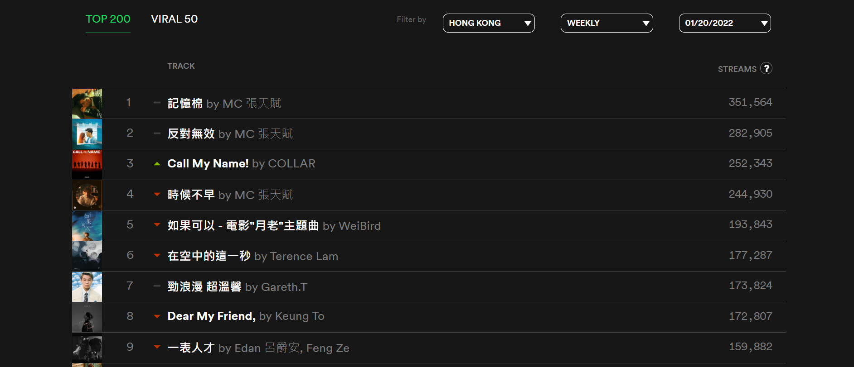

Data collection
Leftover
Leftover
What we do with Spotipy
Business values
Data collection
Data processing
Findings
Challenges and next steps
Conclusion
Data collection
Leftover

Slide 5
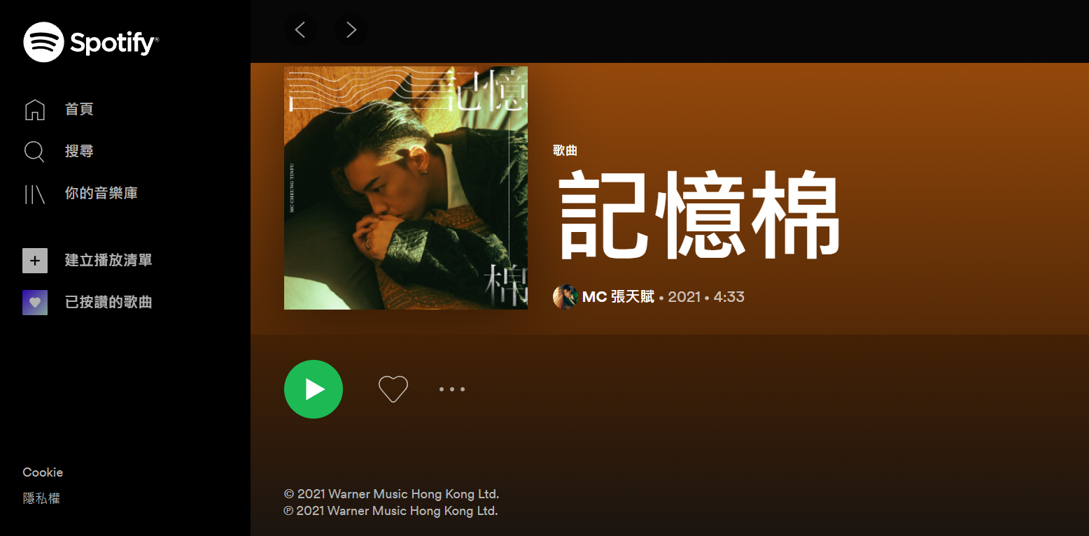

Data collection
Leftover
What we do with Spotipy
Business values
Data collection
Data processing
Findings
Challenges and next steps
Conclusion
Data collection
Leftover

Slide 6
Data collection
Leftover
What we do with Spotipy
Local song list
Time span: 2020-2022
Weekly vs Daily
Business values
Data collection
Data processing
Findings
Challenges and next steps
Conclusion
Data collection
Leftover
Notes:
1) Local Song List
2) Time Span: 2 years
2019 anti extradition bill movements, Covid19: shift in Canto song theme
2021: emergence of new pop song singers e.g. Terrence Lam, the rise of Mirror
3) Weekly: we had 2 options. As we’re more interested in the yearly trend, plus it is much efficient, we collected weekly data.

Slide 7
Data collection
Leftover
Song name
Singer
Streams
Duration
Music production company
What we do with Spotipy
Business values
Data collection
Data processing
Findings
Challenges and next steps
Conclusion
Data collection
Leftover
Notes:
Data scrapped

Slide 8

Data Processing
Leftover
What we do with Spotipy
Manually input some attributes
Male? Female? Group?
Cantonese? English? Mandarin? Others?
Data Cleaning
Business values
Data collection
Data processing
Findings
Challenges and next steps
Conclusion
Data processing
Leftover
Notes:
1) Manually input some attributes
2) Male? Female? Group?
3) Cantonese? English? Mandarin? Other? : other lang not that common
4) Data Cleaning

Slide 9
Data Processing
Leftover
What we do with Spotipy
Combining all the data
Top 200 Weekly List: 2020-2021, 2021-2022
Song, singer, streams, duration,
music production company, gender, language
Business values
Data collection
Data processing
Findings
Challenges and next steps
Conclusion
Data processing
Leftover

Slide 10




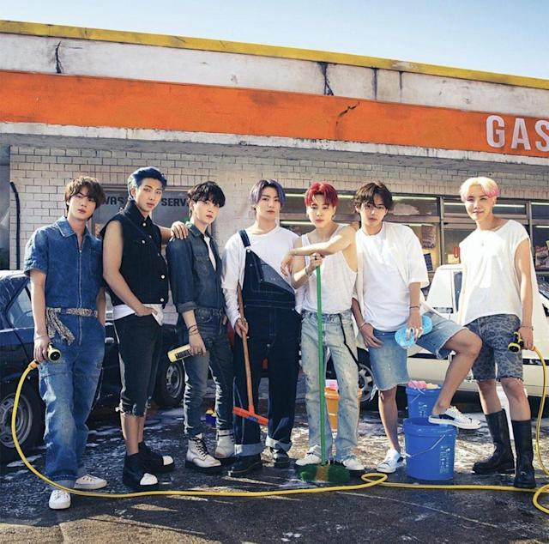

Findings
Leftover
Leftover
Good afternoon
What we do with Spotipy
Business values
Top 5
2020 Top 5 artists
Top 5
2020 Top 5 earnings
(Streams)
Top 5
2020 Top 5 Songs
Data collection
Artists
Earnings
Songs
Data processing
Top 5
2021 Top 5 artists
Top 5
2021 Top 5 earnings
(Streams)
Top 5
2021 Top 5 Songs
Artists
Earnings
Songs
Findings
Challenges and next steps
Your top mixes
Conclusion
Dear Jane Mix
Blackpink Mix
Eason Chan Mix
BTS Mix
Ed Sheeran Mix
Cantopo, 13,536,077
K-Pop, 11,715,465
Cantopop, 8,965,995
K-Pop, 8,004,148
Pop, 7,392,459
Findings
Leftover
Notes:
BDF, songs attibutes
2020:
2 Cantopop singers in top 5, 2 Korean, 1 western
With top number of streams at 13M while 7M for 5th

Slide 11
Findings
Leftover
Leftover
Good afternoon
What we do with Spotipy
Business values
Top 5
2020 Top 5 artists
Top 5
2020 Top 5 earnings
(Streams)
Top 5
2020 Top 5 Songs
Data collection
Artists
Earnings
Songs
Data processing
Top 5
2021 Top 5 artists
Top 5
2021 Top 5 earnings
(Streams)
Top 5
2021 Top 5 Songs
Artists
Earnings
Songs
Findings
Challenges and next steps
Top streams earnings
Conclusion
Dear Jane
Blackpink
Eason Chan
BTS
Ed Sheeran
HK$324,866
HK$281,171
HK$215,184
HK$192,100
HK$177,419
Findings
Leftover
Notes:
For each stream of at least 30sec, Spotify pays USD$0.024 to singers,
highest earner got $300K in 2020 (sadly shared by 4 people) for Dear Jane while the fifth is $180K

Slide 12





Findings
Leftover
Leftover
Good afternoon
What we do with Spotipy
Business values
Top 5
2020 Top 5 artists
Top 5
2020 Top 5 earnings
(Streams)
Top 5
2020 Top 5 Songs
Data collection
Artists
Earnings
Songs
Data processing
Top 5
2021 Top 5 artists
Top 5
2021 Top 5 earnings
(Streams)
Top 5
2021 Top 5 Songs
Artists
Earnings
Songs
Findings
Challenges and next steps
Top streams earnings
Conclusion
銀河修理員
Señorita
想見你想見你想見你
Memories
Binding Lights
Dear Jane , 4,177,287, Can
Shawn Mendes, Camila Cabello, 3,621,541, Eng
831, 3,523,972, Man
Maroon 5, 3,386,878, Eng
The Weekend, 3,026,787, Eng
Findings
Leftover
Notes:
As for top songs
Only one Cantopop from Dear Jane, 4M streams
While the Eng occupied the most places
In short, only Dear Jane and Eason in top 5 in 2020

Slide 13
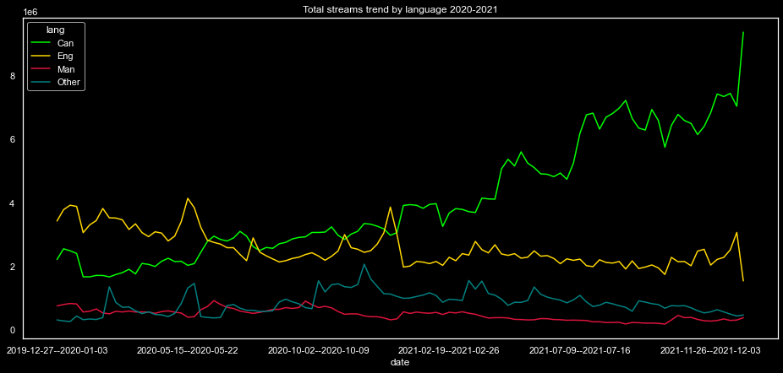
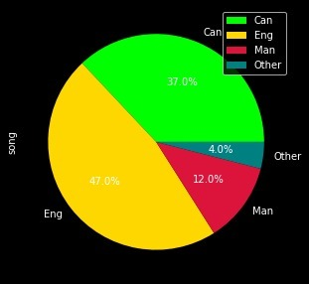
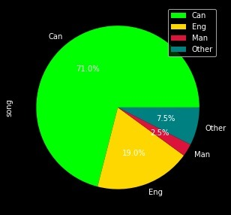
Findings
Leftover
What we do with Spotipy
Business values
Data collection
2020
2021
Data processing
Total top 200: 360M vs 480M
Can: 130M vs 300M
Eng: 150M vs 120M
Man: 30M vs 20M
Others: 40M vs 50M
+30%
Findings
+120%
37%
71%
Challenges and next steps
-24%
47%
Conclusion
-41%
19%
+9%
Findings
Leftover
Notes:
Trend showing total streams by lang in 2020.
At the beginning of the year, Canto pop was roughly 20% below Eng songs, until 2nd half > overtook the 1st place, but the gap was not so significant
But starting from 2021, Cantopop soared and the growth momentum was increasing while all other types recorded a significant drop.
So, despite the drop in Eng, Man and others, total market had a growth by 30% driven by Cantopop which showed a double
Within Spotify, Canto now took over 70% share of streams, and expect to grow further this year

Slide 14
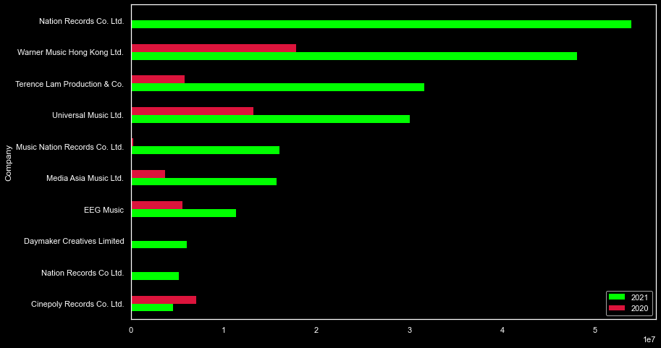
Findings
Leftover
Leftover
What we do with Spotipy
18%
Business values
16%
Data collection
11%
Data processing
10%
Findings
5%
5%
Challenges and next steps
4%
Conclusion
2%
2%
2%
Findings
Leftover
Notes:
As seen Cantopop market actually is not dead, but a v-shape rebound, which label is driving?
Green for 2021, red for 2020:
There are about 80 labels in 2021, but these 10 contributed 75% of streams.
Within these 10, let‘s shed the light on the top 4 accounting for over 50%
But, who are the singers?

Slide 15




Findings
Leftover
Leftover
Good afternoon
What we do with Spotipy
Business values
Top 5
2020 Top 5 artists
Top 5
2020 Top 5 earnings
(Streams)
Top 5
2020 Top 5 Songs
Data collection
Artists
Earnings
Songs
Data processing
Top 5
2021 Top 5 artists
Top 5
2021 Top 5 earnings
(Streams)
Top 5
2021 Top 5 Songs
Artists
Earnings
Songs
Findings
Challenges and next steps
Your top mixes
Conclusion
Terence Lam Mix
Dear Jane Mix
陳卓賢 Ian Mix
Jer 柳應廷 Mix
Edan 呂爵安 Mix
Cantopo, 31,638,161
Cantopop 21,988,050
Cantopop, 15,470,508
Cantopop, 13,238,839
Cantopop, 12,974,668
Findings
Leftover
Notes:
Not surpurisingly, all are Cantopop singers in top 5
With Terence Lam taken the champion with over 30M streams while the 3rd, 4th, 5th from the members of single group, Mirror, while Dear Jane went down to the sec place, showing a huge increase in streams though
Basically, these 3 parties, together with a new singer, MC Cheung, which we will see in a sec, 4 parties eat up 50% of share in 2021.

Slide 16
Findings
Leftover
Leftover
Good afternoon
What we do with Spotipy
Business values
Top 5
2020 Top 5 artists
Top 5
2020 Top 5 earnings
(Streams)
Top 5
2020 Top 5 Songs
Data collection
Artists
Earnings
Songs
Data processing
Top 5
2021 Top 5 artists
Top 5
2021 Top 5 earnings
(Streams)
Top 5
2021 Top 5 Songs
Artists
Earnings
Songs
Findings
Challenges and next steps
Top streams earnings
Conclusion
Terence Lam
Dear Jane
陳卓賢 Ian
Jer 柳應廷
Edan 呂爵安
HK$759,316
HK$527,713
HK$371,292
HK$317,732
HK$311,392
Findings
Leftover
Notes:
With such increase in streams, of coz their income shot up proportionally
Dear Jane, 300K in 2020, Terence Lam such a one-man band company earned 760K in 2021 while 3 Mirror members got $1M from just a platform last year.

Slide 17





Findings
Leftover
Leftover
Good afternoon
What we do with Spotipy
Business values
Top 5
2020 Top 5 artists
Top 5
2020 Top 5 earnings
(Streams)
Top 5
2020 Top 5 Songs
Data collection
Artists
Earnings
Songs
Data processing
Top 5
2021 Top 5 artists
Top 5
2021 Top 5 earnings
(Streams)
Top 5
2021 Top 5 Songs
Artists
Earnings
Songs
Findings
Challenges and next steps
Your top mixes
Conclusion
E先生 連環不幸事件
一人之境 in C major
時光倒流一句話
反對無效
隔離 - Studio Live Duet
Edan 呂爵安, 7,414,343, Can
Terence Lam, 6,638,550, Can
Terence Lam, 5,736,137, Can
MC 張天賦, 4,967,588, Can
Jace Chan, Terence Lam, 4,909,156, Can
Findings
Leftover
一人之境 in C major
Notes:
Here comes popular songs:
MC Cheung, one single song took 5m streams and this song was released in mid 2021. LY, his total screams recorded 12M
Although Edan, a member of Mirror, was on top of the list, he is not the king
The real king on Spotify was Terence Lam, who took 3 places out of 5

Slide 18









Findings
Leftover
Leftover
What we do with Spotipy
1 |  | E先生 連環不幸事件 | Edan 呂爵安 | 4:28
2 |  | Dear My Friend, | Keung To | 3:52
3 |  | 不可愛教主 | Anson Lo 盧瀚霆 | 3:49
4 |  | 小諧星 | Edan 呂爵安 | 4:37
5 |  | Master Class | Keung To | 3:33
6 |  | 俏郎君 | Hins Cheung | 4:40
7 |  | DWBF | 陳卓賢 Ian | 3:18
8 |  | 反對無效 | MC 張天賦 | 3:48
9 |  | 神隊友 | Anson Lo 盧瀚霆 | 3:01
10 |  | Warrior | MIRROR | 4:07
Business values
Data collection
Data processing
Findings
Challenges and next steps
Conclusion
KKBOX 2021 HITS
Cantopop, 10 songs, 39min 13sec
Findings
Leftover
Notes:
Not only Spotify, as a fan of Cantopop, we looked into the ranking from the other platform, KKBOX.
Surprisingly, it showed a different pic vs previous one. Terence Lam was out of top 10 with 8 places occupied by Mirror.
May be KKBOX is Mirror’s world.

Slide 19
Findings
Leftover
Leftover
What we do with Spotipy
Cantopop +120% vs 2020, with 71% in 2021
Shift value proposition to Cantopop
Compare top labels, singers, songs performance across platforms
Commercials based on target audience
Business values
Data collection
Data processing
Findings
Challenges and next steps
Conclusion
Findings
Leftover
Notes:
In short, from the basic data facts, a few points to note.

Slide 20
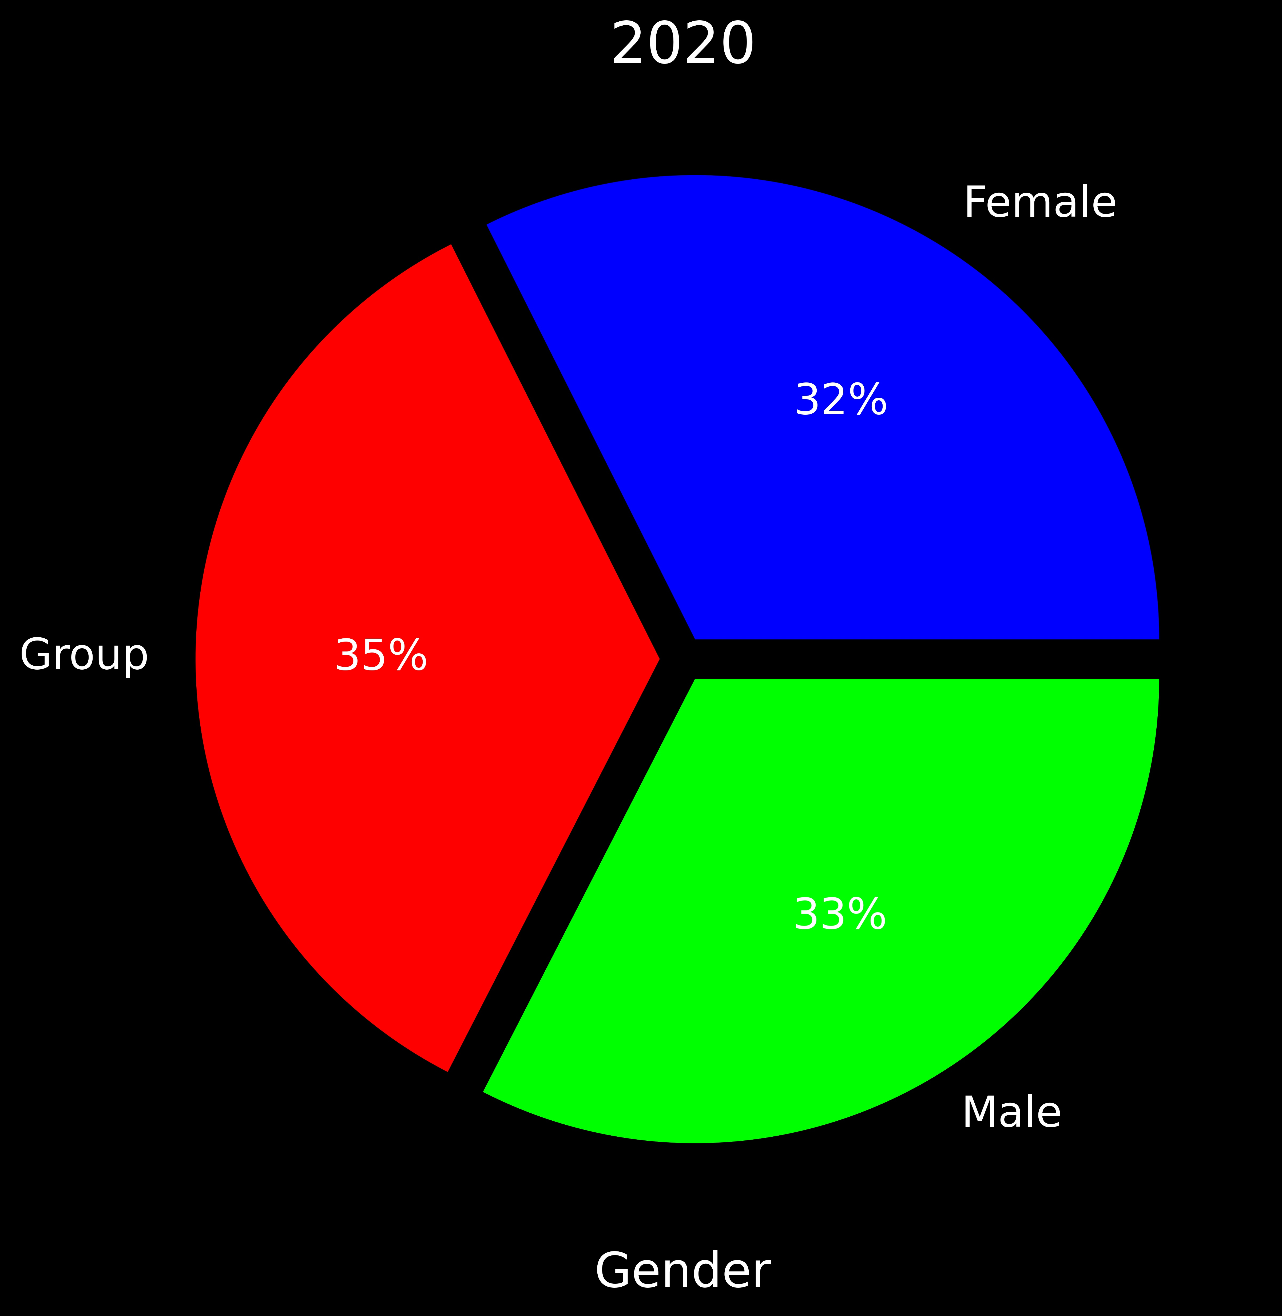
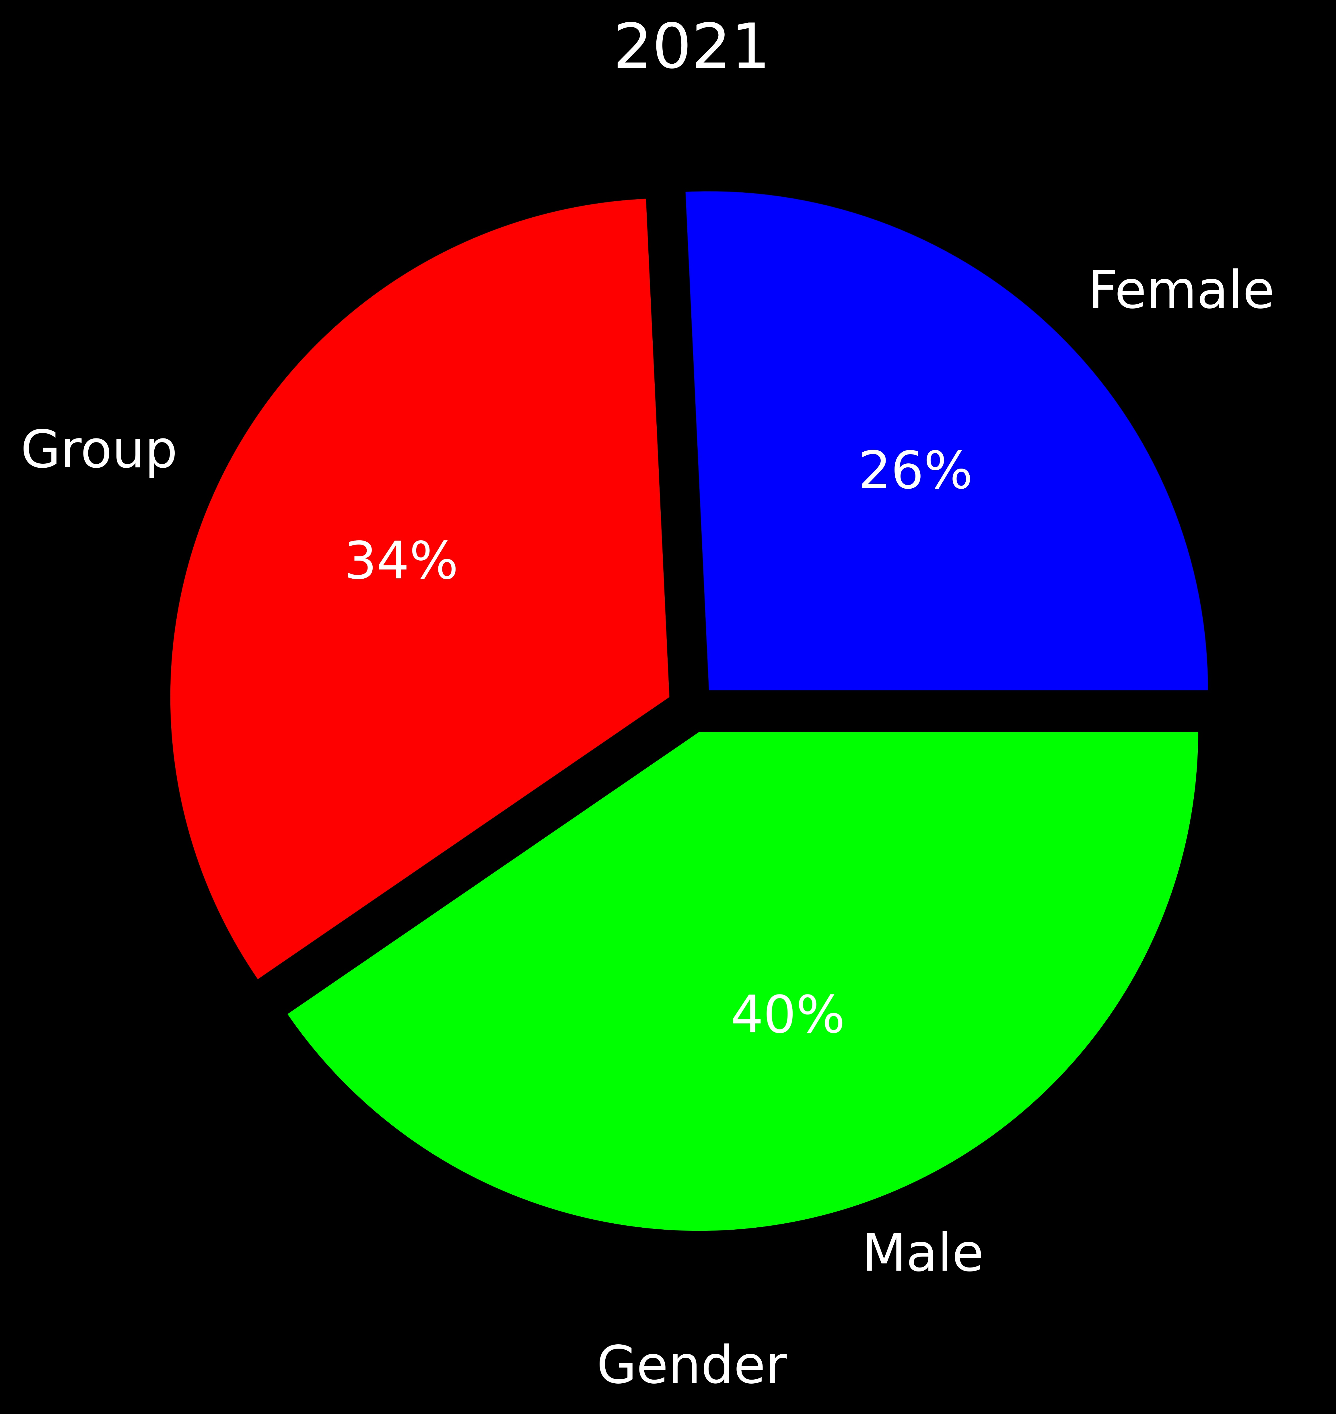
Findings
Leftover
Leftover
What we do with Spotipy
Business values
No. of Stream Average (Group by Gender) (2020 vs 2021)
Data collection
Data processing
Total top 200: 32.6k vs 50.2k
Male: 32.1k vs 58.3k
Female: 31.9k vs 37.1k
Group: 34.5k vs 48.8k
+54%
+182%
32%
26%
Findings
34%
+16%
35%
Challenges and next steps
+41%
33%
40%
Conclusion
Findings
Leftover

Slide 21
Findings
Leftover
Leftover
What we do with Spotipy
Business values
Data collection
Song Duration Average (Group by Language) (2020 vs 2021)
Cantonese: 252.6s vs 244.0s
English: 199.1s vs 203.4s
Mandarin: 255.9s vs 271.1s
Others: 209.6s vs 205.6s
Z-Test : P-value of 0.00083
Data processing
-8.6s
Findings
+4.3s
Challenges and next steps
+15.2s
Conclusion
-4.0s
Findings
Leftover

Slide 22
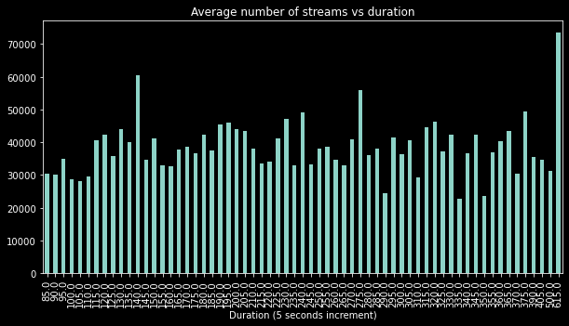
Findings
Leftover
Leftover
What we do with Spotipy
Business values
Data collection
Data processing
Findings
Challenges and next steps
Conclusion
Findings
Leftover

Slide 23
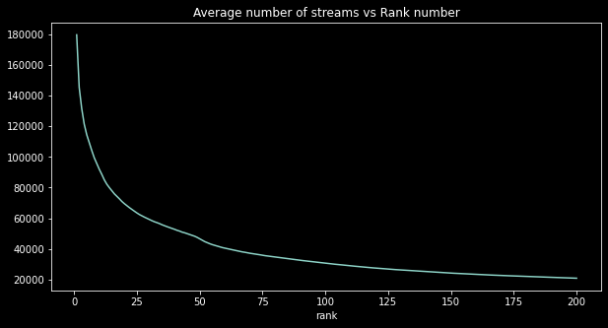
Findings
Leftover
Leftover
What we do with Spotipy
Business values
Data collection
Data processing
Findings
Challenges and next steps
Conclusion
Findings
Leftover

Slide 24
Findings
Leftover
Leftover
What we do with Spotipy
Business values
Data collection
Data processing
Findings
49
Challenges and next steps
Conclusion
49%
60
Findings
Leftover

Slide 25
Findings
Leftover
Leftover
What we do with Spotipy
Business values
Average First Ranking of Cantonese Song Reaching Top 10:
10.0
7.5 to 12.6 (95% Confidence Interval)
Data collection
Data processing
Findings
Challenges and next steps
Average Staying Time in Top 60 after Reaching Top 10:
13.4 weeks
11.1 to 15.7 weeks (95% Confidence Interval)
Conclusion
Findings
Leftover

Slide 26

Challenges and next steps
Leftover
403 error
Manual input attributes
Next steps:
User demographics
Cross platform comparison
Machine learning recommendations
What we do with Spotipy
Business values
Data collection
Data processing
Findings
Challenges and next steps
Conclusion
Challenges and next steps
Leftover

Slide 27

Conclusion
Leftover
Cantopop +120% LY, expect to grow further TY
4 parties occupied 50% share in Spotify, while performance varies across platforms across platforms
To close gap vs male, look for more female/groups
Good songs stay for 3 months, hope to see at least 4 good songs annually
What we do with Spotipy
Business values
Data collection
Data processing
Findings
Challenges and next steps
Conclusion
Conclusion
Leftover

